Slide 1
HL7 Da Vinci Training
February 23, 2025
Coverage Requirements Discovery (CRD) Deep Dive
2025 HL7 Da Vinci Burden Reduction and Payor API Implementer Support
®Health Level Seven and HL7 are registered trademarks of Health Level Seven International, registered with the United States Patent and Trademark Office.

Slide 2

Who am I?
Name: Lloyd McKenzie
Company: Dogwood Health
Background:
One of FHIR’s 3 initial editors
Co-chair FHIR-Infrastructure, past chair FHIR Management Group, FMG member
HL7 Fellow
Technical lead for CRD IG
Da Vinci Deputy Technical Director
lloyd@dogwoodhealthconsulting.com

Slide 3
This presentation
Is part of a set of introductory training materials for the April 2025 Da Vinci Education Event
Can be downloaded here:
https://github.com/FHIR/documents/tree/master/presentations/2025-04-DaVinci
Is licensed for use under the Creative Commons, specifically:
Creative Commons Attribution 3.0 Unported License
Do with it as you wish, so long as you give credit
Notes:
Talk about pausing between modules

Slide 4

Pre-requisites & Post-requisites
Before taking this course, you should take:
Introduction to FHIR
How to read a FHIR IG
USCDI/US Core
SMART on FHIR & CDS Hooks
Da Vinci Healthcare Record Exchange (HRex)
This course is a prerequisite to
Documentation and Templates Rules (DTR)

Slide 5

Course Objectives
After completing this course, you should be able to:
Explain the relationship between CRD and CDS Hooks
List the mandatory and optional hook types used by CRD
Choose the appropriate CRD response type for a particular type of information
Fill out the coverage-information extension
Describe the full workflow covered by the CRD specification

Slide 6
Outline
CRD Outline
CRD Overview
CRD Hooks
Response Types
Coverage Information
CRD Workflow
Additional Considerations

Slide 7
CRD Overview
CRD Outline
CRD Overview
CRD Hooks
Response Types
Coverage Information
CRD Workflow
Additional Considerations

Slide 8
What is CRD?
Coverage Requirements Discovery
Decision support tool for providers
“What does the payer know that can help me right now?”
Called as part of clinical workflow
Required to provide information about coverage
MAY provide other types of information

Slide 9
Primary objectives of CRD
Coverage information affects provider decisions
Is this intervention covered?
If not, intervention may not be workable for patient
Is prior authorization needed?
If so, may impact service timing, which may make a different therapy a better choice
Do I need to collect any data from the patient to support authorization/claims?
If so, better to do it now
CRD strives to have answers to these questions at the time the provider is
Writing orders, booking appointments, admitting the patient

Slide 10
A pleasant side effect
In some cases, a payer may determine:
Yes, this service is covered
The service requires prior authorization
All information needed for an authorization is available in the record
Authorization requirements are met
CRD allows an authorization number to be provided even though no authorization was formally sought

Slide 11
What CRD is not
Not a formal substitute for prior authorization
Needed data may be unavailable
CRD cannot refuse authorization
Not a tool for back-office staff
They might use CRD, but not targeted at them
Not a data collection tool
Data is held only for audit purposes

Slide 12
How CRD is different
Data coming to payer will be clinical
SNOMED, text, etc.
Actual billing codes could vary from what’s submitted
Data may be incomplete
May be missing date of service, performer/location, indication, etc.
No dollar amounts are specified
Payer response must be real-time

Slide 13
Conformance & General Expectations

Slide 14
Capability Statements
CRD Service
One statement, supports US Core 3.1.1, 6.1.0, 7.0.0
Acts as a FHIR client accessing EHR data
CRD Client
Three statements – one each for US Core 3.1.1, 6.1.0, 7.0.0
Exposes EHR data to CRD service

Slide 15
Must Support
CRD Clients
SHALL expose elements to payers that they expose to other users so long as privacy constraints permit
CRD Servers
Leverage data provided as part of their decision support processes as needed
Fine to ignore data if not needed
Not fine to ignore data that’s present and needed
In responses, must populate all elements for which a value exists

Slide 16
Security expectations
All data is exchanged over TLS (as per HRex)
CRD Clients decide whether to invoke CRD services and what the payer can see
CRD service queries need to adhere to ‘minimum necessary’ rules
Data received is limited to providing decision support, audit, and tracking issued authorizations
Data is limited to scopes server needs and client is willing to offer
Token expiration should be 30 seconds or less

Slide 17
Identity expectations
CRD clients will often invoke hooks on ‘draft’ resources
Cards and system actions seeking to update or reference those resources will need a reliable id
Therefore
CRD clients SHALL support use of whatever id exists on the draft resources for actions even if those ids would not be valid on the REST API

Slide 18
Logging expectations
CRD responses can have financial ramifications
Therapies ordered on presumption of coverage
Actions taken based on granted prior authorization
Assertions of coverage and authorization based on data retrieved
Clients & Servers must log their interactions
Should be tied to the hookInstance id for the hook invocation
Include what clinical information was shared
Logs should be appropriately protected

Slide 19
Other general expectations
Response time:
5 seconds (10 seconds if no prior hook for the patient in the last 24 hours)
90% of invocations must meet this response time
Results longer than this may be ignored
CRD clients aren’t required to block
Further discussion on strategies to meet these requirements at the training event
Results must be ‘reliable’
Guidance on coverage, authorization, needed data, etc. must be as accurate as that given by phone, fax, or portals
Results must be ‘relevant’
Don’t give suggestions to users they aren’t going to find helpful

Slide 20
CRD Hooks
CRD Outline
CRD Overview
CRD Hooks
Response Types
Coverage Information
CRD Workflow
Additional Considerations

Slide 21
Supported CRD Hooks
order-select*
order-sign
order-dispatch
appointment-book
encounter-start*
encounter-discharge
Notes:
You can support others, but that’s outside CRD’s scope
Bold = must support
* = useful for caching
Not all hooks will exist
This is the typical order

Slide 22
Hook support expectations
Not all processes will exist in all systems
E.g. emergency department doesn’t take appointments
Community clinic might not ‘dispatch’ lab orders
If the process exists for a given resource type in a client and the hook is ‘mandatory’, the hook must be supported
For payers, responses must be provided for mandatory hooks, optional for others
It’s possible to support hooks outside the CRD scope too, but no obligation on communication partners

Slide 23
Order-related hooks
All the order hooks (select, sign, & dispatch) support:
CommunicationRequest – Request for information transfer
Extension to CDS Hooks
DeviceRequest – Durable medical equipment and other devices
MedicationRequest – Drug orders and prescriptions
Only used where NCPDP doesn’t already cover the use-case
NutritionOrder – Food supplements, tube feeding
ServiceRequest – Lab, DI, referrals, anything not covered elsewhere
VisionPrescription – Glasses & contacts
EHRs only need to support orders their system produces
Notes:
Drill into each of the profiles and look at an example

Slide 24
Order collections
All the order hooks can pass in multiple orders
What orders can go together is driven by provider workflow
Multiple drugs in a prescription
Multiple lab tests in a requisition
Order that combines medications, devices, and referrals, etc.
Combination is not impacted by how things might be billed later
It’s not even a given that the orders will be filled at the same time by the same provider

Slide 25
Order Select
Status: Optional
Recommended at minimum to support caching
Payload:
patientId, encounterId, draftOrders
Allows early intervention in order cycle
E.g. “Not covered, but here’s a covered alternative” as soon as product selected
Could fire multiple times as order is edited
Should never trigger unsolicited prior auth
Never return a coverage-information that says more info needed

Slide 26
Order Sign
Status: Required
Payload:
patientId, encounterId, draftOrders
Fires only when orders are all done and ready to print/sign
Ok to send unsolicited auth at this stage
Must return a coverage-information response
Even if it says more information needed

Slide 27
Order Dispatch
Status: Required
Payload:
patientId, encounterId, draftOrders
Fires if client performs a dispatching process asking a specific performer to fulfill an undirected order
Only relevant if the initial response indicated “information needed” of either performer or location
Must return a coverage-information response
Even if it says more information needed

Slide 28
Appointment Book
Status: Required
Payload:
patientId, encounterId, appointments (with order or without)
Must return a coverage-information response
Even if it says more information needed
Fires when an appointment is scheduled.
Useful when booking appointments
with no order or order having no coverage-information
where coverage-information indicated more information was needed

Slide 29
Encounter Start
Status: Optional
Recommended at minimum to support caching
Payload:
patientId, encounterId
In addition to caching information, can return coverage-information based on the encounter service-type
Can also identify data to capture or activities to perform to close gaps

Slide 30
Encounter Discharge
Status: Optional
Payload:
patientId, encounterId
Will not return coverage-information
Primarily to allow review of discharge plan and ensure necessary documentation has been captured to support eventual claims

Slide 31
Response Types
CRD Outline
CRD Overview
CRD Hooks
Response Types
Coverage Information
CRD Workflow
Additional Considerations

Slide 32
What is a ‘Response Type’?
CDS Hooks services can respond in two ways:
Cards: Content displayed to users, possibly with the ability for them to take action
System actions: Automated updates to records in the CDS Hook client system
Finite set of elements that can appear on either of those
CRD defines profiles for common kinds of responses that are relevant for payers to provide
Helps ensure consistency and interoperability
Theoretically possible for payers to provide other types of responses
These are outside the scope of CRD

Slide 33
Generic response rules
Cards
uuid mandatory
indicator (info/warning/critical) are from provider’s perspective
source.label must be patient/provider-friendly name for payer
source.topic is mandatory and draws from CRD card types
summary should be actionable
detail should put highest priority information first. If there are links, repeat them in links.url
links.url should point to location in page, not start of document
No expectation to support overrideReason
davinci-crd.associated-resource extension is mandatory

Slide 34
Generic response rules (cont’d)
Keep the number of cards manageable
Most important ones first
System action information should not be replicated in cards

Slide 35
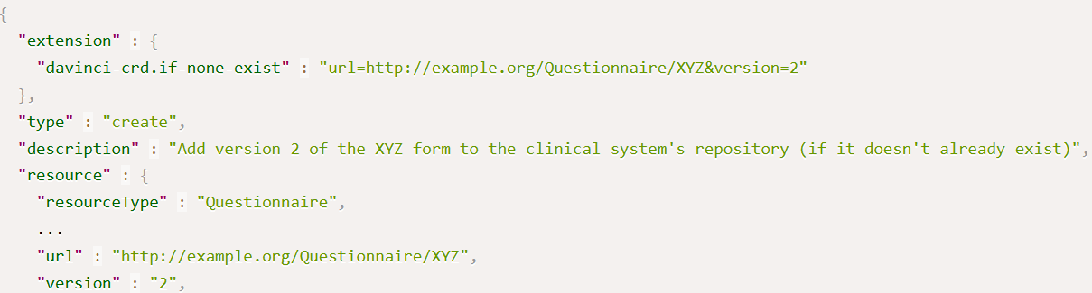
Card Suggestion Handling
If a suggestion will perform multiple actions, treat as a transaction
This includes handling references between cards
CRD defines an “if-none-exist” extension for conditional creates
Used with the Questionnaire Task card

Slide 36
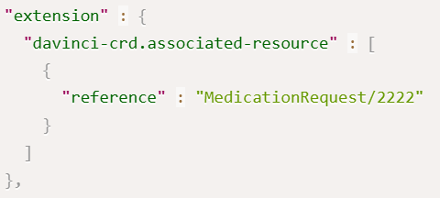
Linking cards to requests
A single hook may be invoked with multiple orders or appointments
It’s sometimes useful to know which resource(s) a response card relates to.
The ‘associated resource’ extension must be added to cards if the card is related to any of the passed resources

Slide 37
Response Type Overview
CRD defines 8 types of possible responses:
External Reference (must support)
Instructions (must support)
Coverage Information (must support and return)
Propose Alternate Request
Identify Additional Orders
Request Form Completion
Create or Update Coverage Records
Launch SMART Application

Slide 38
External Reference
Returns: Card
Must be supported by CRD clients and servers
Must have 1..* card.links with link.type of ‘absolute’
Allows payer to link to relevant clinical guidelines, prior auth requirements, printable forms, registries of in-network providers, etc.
summary & detail provide information on what the links are for
detail will typically not be needed.
Example

Slide 39
Instructions
Returns: Card
Must be supported by CRD clients and servers
Must have summary and will typically have detail
Could contain any sort of decision support
Clinical reminders
Notifications of potential duplicate therapies or contraindications
Warning about deviation from guidelines
Information about coverage limits or predicted costs
Etc.
Example

Slide 40
Propose Alternate Request
Returns: Card
Optional for CRD clients and servers
Must have a suggestion with actions to update one or more requests or remove one or more requests and add one or more requests.
Allows proposing to change what’s being ordered
Something not covered -> something covered
Change to required first line therapy
Change to recommended best practice
Change to lower-cost alternative

Slide 41
Propose Alternate Request (cont’d)
Clinician can click to update their order
Could be multiple alternate suggestions
summary (and maybe detail) should fully explain the nature of the change
The new ‘request’ resources must align with Da Vinci profiles
Only MS elements are likely to be used
Suggestions may have contained resources (e.g. Medication)
Example

Slide 42
Identify Additional Orders
Returns: Card
Optional for CRD clients and servers
Must have a suggestion with actions to add additional requests.
Allows adding additional authorizations to a set of orders
Add additional tests to close gaps
Add recommended concomitant therapies (e.g. anti-nausea)
Add required ‘monitoring’ orders to ensure safety/effectiveness

Slide 43
Identify Additional Orders (cont’d)
Clinician can click to supplement their order(s)
If there are multiple options, they should be separate suggestions
summary (and maybe detail) should fully explain the nature of the addition
The new ‘request’ resources must align with Da Vinci profiles
Only MS elements are likely to be used
Again, contained resources are possible
Example

Slide 44
Request Form Completion
Returns: Card or SystemAction
Site-specific agreement between payer and provider organization on approach
Optional for CRD clients and servers
Must have a suggestion with an action to create a Task seeking completion of a Questionnaire
Used to request completion of forms outside the scope of DTR
Recommended clinical assessments
Decision trees to guide clinical actions (e.g. opioid prescribing guidelines)
Satisfaction surveys
Etc.

Slide 45
Request Form Completion (cont’d)
Task will identify:
Form to complete (available within EHR or retrievable via canonical)
Who’s asking
Who needs to complete
When
Why
What to do when complete
Profile
Example

Slide 46
Create or Update Coverage Records
Returns: Card or system action
Optional for CRD clients and servers
Must have a suggestion with an action to create or update a Coverage instance
Allows a payer to correct supplement an EHR’s records of a patient’s insurance
E.g. correcting status, expiration dates
Using system action needs to be negotiated with client
Example

Slide 47
Launch SMART Application
Returns: Card
Optional for CRD clients and servers
Returns a link with type of “smart”
Allows recommending use of relevant apps
Clinical guideline support
Prescribing aids
Registry access
Etc.
Not for use in invoking DTR (see the ‘Coverage’ response type)
Example

Slide 48
Coverage Information
CRD Outline
CRD Overview
CRD Hooks
Response Types
Coverage Information
CRD Workflow
Additional Considerations

Slide 49
Coverage Information
Returns: System action
Must support for clients and servers.
Servers must provide on order-sign, order-dispatch, appointment-book
Exception if client says they don’t want it
Exception for order-dispatch and appointment-book if nothing’s changed
System action will ‘update’ the Request or Appointment to add (or change) one or more coverage-information extensions
Extension will indicate:
Is this covered? Is prior authorization needed? Is additional data needed?

Slide 50
Coverage Information Use Case
Primary use case:
Give providers coverage information at the time of ordering/booking
Allows providers to
Change the therapeutic approach to one that will work for the patient
Lack of coverage may mean inability to adhere
Account for potential time delays due to prior authorization requirements
Ensure all relevant information is captured at the time of the patient visit
Discuss options and trade-offs with patient
Reduce administrative overhead in communicating with payers
No portals, faxes, reduced back-end staff interaction

Slide 51
Coverage Information is not a eligibility check
The only data the payer gets is:
What appears on the order
What data exists in the EHR
No expectation of billing codes or modifiers
No guarantee all desired information will be present
Performer, location, date, etc.
One order could result in a wide range of actual claim codes

Slide 52
What does a payer do?
Map ‘order’ codes to candidate claim codes
Look for other relevant information in the client record
If there are multiple possible claims
If possible, evaluate all possibilities
Can return multiple coverage-information repetitions for different assumptions
Can qualify each one by billing code or conditions (e.g. in-network/out-of-network)
If not, indicate what additional information is needed to narrow things sufficiently for evaluation

Slide 53
What billing codes are possible?
The code used when ordering/booking an appointment/etc. will not necessarily be the code on the claim
This is true even if the ordered code is a CPT code
Payers will need to figure out what possible billing codes are ‘reasonably likely’ for a given order
If there are a small enough number, evaluate coverage requirements for all
If coverage requirements vary, return a separate coverage-information extension for each ‘set’ with different rules
If there are too many to reasonably evaluate
Return coverage-information saying “detailed-code” is needed

Slide 54
Billing code considerations
If there are multiple possible billing codes
More challenging to return unsolicited prior authorization
Mapping order codes to billing codes is complex
See the presentation at the Da Vinci education event

Slide 55
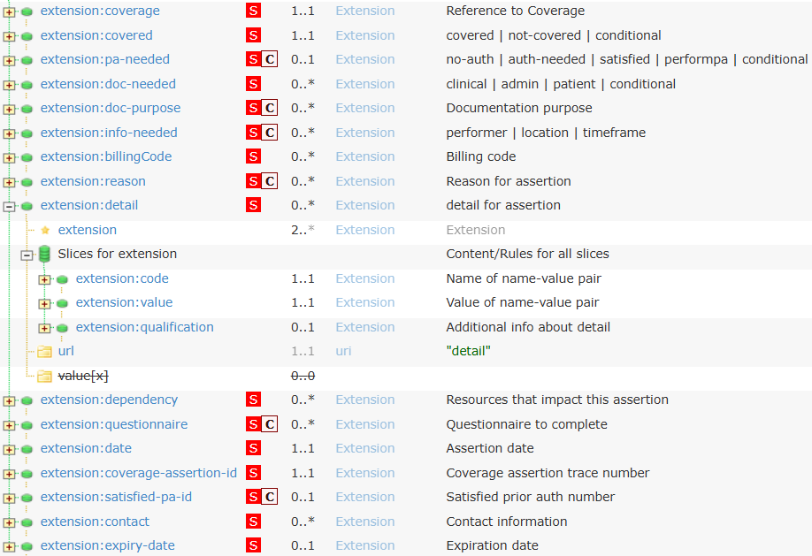
Coverage Information extension

Slide 56
Coverage Information - coverage
‘coverage’ is a Reference to the Coverage that applies to the assertions given
This will usually be the Coverage passed during pre-fetch
The Reference must point to a Coverage record on the EHR

Slide 57
Coverage Information - covered
Answers: covered, not-covered, conditional
Mandatory
Does coverage exist for this service at all?
Can the coverage or member be found?
Is the coverage in effect?
Does the coverage apply to this patient?
Does the expected service fall within the scope of the coverage?
Has the patient hit their limit?
Doesn’t care about deductibles or co-pay
Doesn’t care about prior authorization requirements

Slide 58
What does ‘conditional’ mean?
More information is needed to determine if covered or not
Used when number of possible ‘claim’ options is too large to evaluate
If set as ‘conditional’, must also include ‘info-needed’ to say what additional information is needed
Can be one (or more) of:
Performer
Location
Time-frame
Contract-window
(maybe also ‘detailed code’?)
Other

Slide 59
Coverage Information – pa-needed
Must be supported, won’t be present if “not covered”
Answers:
no-auth – Prior authorization isn’t needed
auth-needed – Prior authorization is needed
and can be requested by ordering provider
satisfied – Prior authorization is needed, and has been granted without being solicited
performpa – Prior authorization is needed
But must be requested by performing, not ordering provider
conditional – More information is needed to determine if prior authorization is necessary
Need to specify info-needed

Slide 60
Coverage Information – doc-needed
Is additional information needed?
I.e. should DTR be called?
Who needs to provide the information:
clinical – information may be needed from ordering clinician
Should ideally be captured ‘now’. Clinician must have opportunity
admin – information can be provided by administrative staff
Doesn’t need to happen ‘now’ (but could be if clinician wants answer right away)
Patient – information will need to come from the patient
Should be gathered now to avoid a recall appointment
Conditional – need extra information to decide what documentation is required
Can repeat

Slide 61
Coverage Information – doc-reason
What is the additional documentation for?
Inclusion with prior auth submission
Inclusion with claim submission
Inclusion with order
When sent to performer
Retain for audit (e.g. appropriate use)
Other reasons
Can have more than one

Slide 62
Coverage Information - billingCode
The set of billing codes for which the specified coverage and prior authorization assertions apply
Can be more than one
Should always be specified if the assertion wouldn’t hold for ‘any’ possible billing code for the order

Slide 63
Coverage Information - reason
Must have text if the code isn’t from the value set
Must be specified if info-needed is “other”
Can also specify the reason why the service isn’t covered or requires prior authorization

Slide 64
Coverage Information - detail
Allows providing a name/value/qualifier tuple with additional information about the coverage decision.
Options include:
Allowed-quantity
Allowed-period
In-network copay %
Out-of-network copay %
Authorization only for out-of-network providers
Links to policies
Instructions
Etc.

Slide 65
Coverage Information - dependency
Used when a decision around coverage or prior authorization is based on multiple orders
E.g. Physio is only authorized if the procedure the physio is to help recover from actually happens
Allows linking to the additional related orders that are tied together in the decision
If not present, presumption is that decision is specific to this order alone

Slide 66
Coverage Information - questionnaire
Indicates the form(s) to be filled out by DTR
Canonicals (usually versioned) pointing to the Questionnaires
May be specified if info-needed is present
Optional
My speed up DTR process, however
DTR can work even if only coverage-assertion-id is present

Slide 67
Coverage Information - ids
coverage-assertion-id
Trace number for this assertion of coverage
Used for audit
Also used with the $questionnaire-package operation in DTR
Must always be present
satisfied-pa-id
Used as a prior authorization number when submitting a claim
Must be present if pa-needed = satisfied

Slide 68
Coverage Information – additional metadata
date
The date this assertion was last updated
contact
phone, email or website if there are questions/issues with this coverage assertion
expiry-date
Last date on which the assertions made in this coverage-information are considered valid

Slide 69
Additional coverage information considerations
Subsequent hooks can cause coverage-information to be updated
E.g. order-dispatch or appointment-book after order-sign
Only provide a system action if there’s new information
Coverage assertions are expected to be as valid as if issued by phone or portal
Changes to patient coverage, performer qualifications, etc. may invalidate
Even though no card is returned, CRD clients must still expose coverage decisions (via icons, pop-ups, or some other means)
Example

Slide 70
CRD Workflow
CRD Outline
CRD Overview
CRD Hooks
Response Types
Coverage Information
CRD Workflow
Additional Considerations

Slide 71
Workflow overview
Enable Service
Service Discovery
Hook Prefetch
Invoke Hook
Data Retrieval
Hook Response
Act on hook information

Slide 72
Enabling a service
Clients will determine which payer services they connect to
Each payer must expose a single endpoint
One per coverage if supporting endpoint discovery, one per member otherwise
Some payers might share an endpoint
Enabling will require establishing security credentials & trust relationship
Could be site-to-site
To scale, will likely need a trust network
Client must know which payers a service supports

Slide 73
Enabling a Service (cont’d)
Registration/enabling process will include
What payers does the service support?
Needed so client knows what coverages should trigger the service
Service must be trusted to handle PHI
May require a data sharing agreement
What scopes does the CRD service want
And what is the client prepared to offer
How will identity be verified?
MTLS, FAST UDAP, FHIR Backend Services

Slide 74
CRD Endpoint Discovery
The endpoint for a CRD service can be conveyed in three ways:
Manually as part of service enablement
or via a coordinated update communicated out-of-band
Must be a single endpoint for all coverages for 1+ payers
Via a directory service
Must be a single endpoint for all coverages for 1+ payers
Automatically via HRex endpoint discovery
No more than one endpoint per coverage

Slide 75
CRD Service Discovery
A CRD server’s configuration may change from time to time
What hooks are supported?
What are the prefetch expectations for a hook?
What configuration options are available for the server?
CDS Hooks ‘Discovery’ allows retrieval of this information

Slide 76
Prefetch discovery
Indicates (for a hook) what information the payer always needs
CRD Clients may or may not provide all requested prefetch information
Syntax is a list of queries to run
_include, _revinclude is not supported
Can contain simple embedded FHIRPath (x-fhir-query syntax) that refers to hook context and/or prior query results
Not officially published in CDS Hooks yet, but will be soon and is pre-adopted by CRD

Slide 77
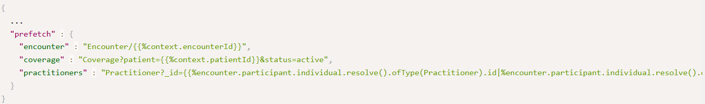
Interpreting prefetch x-fhir-query
%context refers to ‘context’ element in a hook invocation
Each prefetch line defines a new variable which can be used in subsequent prefetches
Only resolve() and ofType() operations are supported
Collections are turned into comma-separated string lists

Slide 78
x-fhir-queries may get long…
"practitioners" : "Practitioner?_id={{
%encounter.participant.individual.resolve().ofType(Practitioner).id|
%encounter.participant.individual.resolve().ofType(PractitionerRole).practitioner.resolve().id|
%encounter.serviceProvider.resolve().ofType(Practitioner).id|
%encounter.serviceProvider.resolve().ofType(PractitionerRole).practitioner.resolve().id|
%context.draftOrders.entry.resource.sender.resolve().ofType(Practitioner).id|
%context.draftOrders.entry.resource.recipient.resolve().ofType(Practitioner).id|
%context.draftOrders.entry.resource.requester.resolve().ofType(Practitioner).id|
%context.draftOrders.entry.resource.performer.resolve().ofType(Practitioner).id|
%context.draftOrders.entry.resource.orderer.resolve().ofType(Practitioner).id|
%context.draftOrders.entry.resource.prescriber.resolve().ofType(Practitioner).id|
%context.draftOrders.entry.resource.sender.resolve().ofType(PractitionerRole).practitioner.resolve().id|
%context.draftOrders.entry.resource.recipient.resolve().ofType(PractitionerRole).practitioner.resolve().id|
%context.draftOrders.entry.resource.requester.resolve().ofType(PractitionerRole).practitioner.resolve().id|
%context.draftOrders.entry.resource.performer.resolve().ofType(PractitionerRole).practitioner.resolve().id|
%context.draftOrders.entry.resource.orderer.resolve().ofType(PractitionerRole).practitioner.resolve().id|
%context.draftOrders.entry.resource.prescriber.resolve().ofType(PractitionerRole).practitioner.resolve().id
}}",

Slide 79
What should be in prefetch?
Typically
patient, requester, location, encounter, device, medication
Can include other information
Can vary by hook type
Can vary by type of request
Must
Be relevant almost always
Respect ‘minimum necessary’
Shouldn’t be the only mechanism the CRD service uses to get data

Slide 80
CRD Configuration
CRD servers may support many capabilities
Coverage information
Unsolicited prior auth
Covered therapy alternatives
Lower cost alternatives
In-network provider options
Duplicate therapy detection
Contraindication detection
Clinical guideline recommendations
Suggestions on missing tests
Some [organizations | departments | users ] may not want all of these
Some of these may also have configurable options
Degree of savings
Types of duplicate therapies to check
Etc.

Slide 81
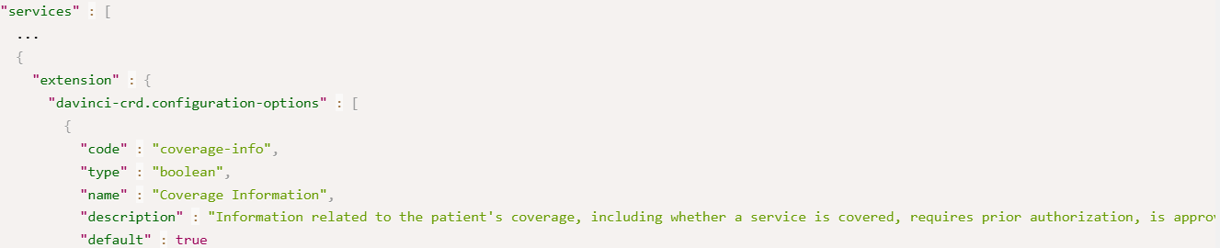
What is CRD Configuration?
List of options the CRD service supports that controls the responses it will provide + allowed values for those options
CRD clients specify the configuration options when they invoke a hook
At minimum must be able to toggle the different CRD card types and whether unsolicited prior authorization is desired

Slide 82
Example Discovery call
Request:
GET [base CRD URL]/cds-services
Response:
See here

Slide 83
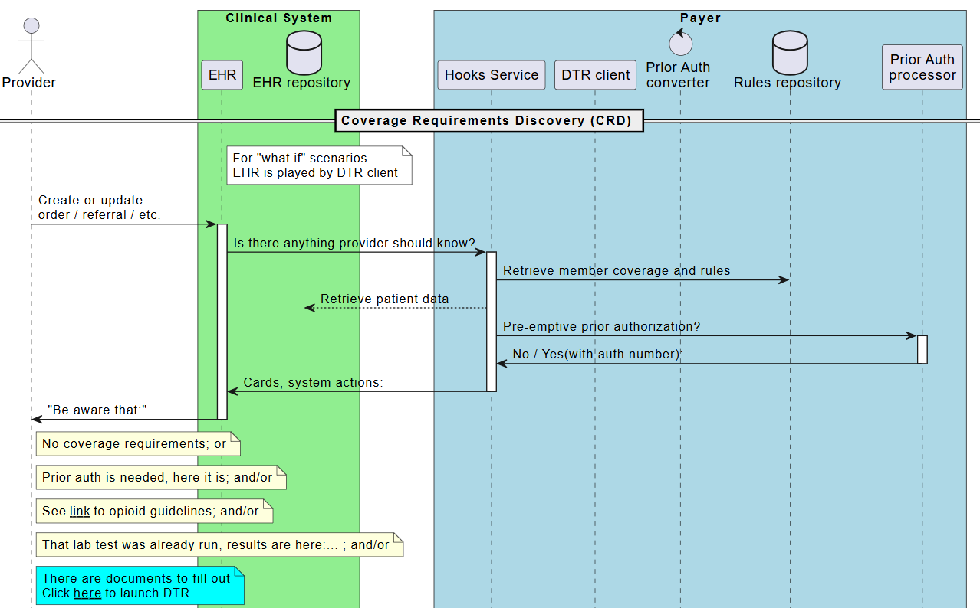
Workflow diagram

Slide 84
Hook invocation - client steps
What’s the probable primary coverage?
Which service should be called?
What prefetch data is needed?
For all orders in the hook invocation
What configuration settings apply?
for this type of order/department/user

Slide 85
Coverage Determination
CRD calls can only be made to a CRD Service associated with ‘active’ coverages
What coverage types are associated with a server are determined at configuration time
The CRD client must have a coverage record associated with the payer(s) tied to the server and that coverage can’t be expired or otherwise inactive

Slide 86
Primary coverage
CRD calls will only expose the ‘primary’ coverage to the server
Coverage Information is limited to the ‘primary’ coverage
Provider won’t be choosing, so CRD client must make its best guess
If there are multiple requests
Pick the one that applies to most; or
Split requests into separate CRD calls
Once you know the coverage, you know the CRD endpoint to call
Once you know the endpoint, you know the desired prefetch and configuration options

Slide 87
Performing prefetch
Prefetch is optional, but strongly encouraged
Clients can optimize data retrieval better than servers can
Every query + response adds delay and slows response to user
Usual query rules apply
Consent, data access permissions
A client can provide some prefetch information but not others
Empty prefetch element means “no data exists”
Missing prefetch element means “this prefetch not performed”
If a prefetch query is run, the whole thing must be run
Some prefetches can be run in parallel, others not
You don’t need to use a FHIR API to execute these

Slide 88
Fetched data profiles
Certain data will typically need to always be accessed
Whether by prefetch or subsequent query
Profiles include:
Device
Encounter
Location
Organization
Patient
Additional profiles from HRex & US Core
Medication, Practitioner, PractitionerRole

Slide 89
Configuration
Totally up to the CRD client how granular configuration should be managed
Can vary by
Department
User
Type of order
Which screen is used to order
Which hook is being used
‘Real’ vs. ‘What-if?’

Slide 90
CRD process for server
Did I get all the prefetches I asked for?
If not, query for the rest
Can I find this coverage/member?
What billing codes are possible?
What additional information should be retrieved?
For each billing code
Is it covered? More info needed? Prior auth needed? Prior auth granted?
Are there other useful things to share?
Create response

Slide 91
Querying data
May need to query CRD client because
Not all prefetches returned
Additional data is needed based on the request(s)
Check the CapabilityStatement of the server to see what query features are supported
_include, etc. may be possible
Query using batch may also be possible
Experiment whether this is more/less performant than individual parallel queries
Can query for prefetch and additional data simultaneously
Can query as requirements are identified

Slide 92
Querying data (cont’d)
Data will be accessed from the CRD client’s FHIR REST endpoint
Access will use the access token provided in the Hook call
Data available will be based on the EHR’s patient access API
Search parameters and data conformance based on US Core
Specifically, US Core 3.1.1, 6.1.0, and/or 7.0.0
Different EHRs may have varying search capabilities and expose varying data elements
We’ll have an Education session on this at the training event
Use CapabilityStatement to see what the server can do
Might want to cache this

Slide 93
‘Standard’ queries
The IG defines a standard set of queries that can be used to retrieve data not retrieved by ‘standard’ prefetch
These queries use _include for efficiency, though not all EHRs will support this
Details can be seen here
Queries can be executed individually, or as a Batch (if EHR supports)
Some servers may have distinct search parameter names
CRD Services SHALL use the search parameter names based on the CapabilityStatement for the EHR FHIR Server
Be sure to check the ‘self’ link to confirm filters were applied

Slide 94
What if key information is missing?
If the base prefetch data required by CRD is
Not included as prefetch data in the hook invocation
Not available when performing a search
I.e. can’t search for it, rather than “no data exists”
Return a 412
If there’s additional data you need to
Verify coverage
Determine authorization requirements
Grant prior auth
Return coverage information as best you can. DO NOT error

Slide 95
What about delegates?
Access token is granted to the CRD service, not third parties
If coverage determination or other decision support will be done by third parties
Requests for data will need to route through the CRD service to the CRD client
Business agreements will need to be in place to allow data to flow

Slide 96
If you can’t find the coverage
If
The member or coverage isn’t recognized
The coverage doesn’t apply to the service
The coverage is expired
Do not error
Return a coverage-information indicating “not covered” and explain why in the reason

Slide 97
Hook Response
For each hook invocation, the CRD service will need to decide what responses to return:
If required prefetches aren’t provided or queriable, may error
Which response types are allowed can be configured by client
If order-sign, order-dispatch, or appointment-book and not disabled by client, must provide coverage information system action
MAY provide any responses where service has something useful to say
CRD clients must differentiate between “no coverage information returned” (e.g. due to error) and “standard coverage expectations apply”

Slide 98
Acting on the Hook Information
If a CRD response includes cards, the CRD client uses its normal CDS Hook process to render those cards to the user
It’s possible there could be cards from decision support sources other than the payer displayed alongside payer cards
Coverage Information is not (typically) displayed as cards
instead, clients render data in other ways
Users may click on cards to access more information or perform one or more of the suggested actions

Slide 99
Rinse and Repeat
The same ‘order’ may trigger hooks multiple times
Multiple calls during order-select
A call during order-sign
A new order-sign if the order gets revised based on decision support responses (from payer or others)
Possible order-dispatch (could be more than one)
Possible appointment-book
Could be multiple appointments per order
Appointments could be revised
Encounter-start
Hooks can be triggered in performing system too (e.g. filler, delegated orders)

Slide 100
Clinical action based on CRD
Clinicians may execute one or more card suggestions
They can also make changes not based on cards
Cancel the order/choose to not sign
Revise the order
Defer the order
Add additional therapies

Slide 101
Card feedback
CDS Hooks provides a mechanism to send ‘feedback’ on cards
Allows indicating
A suggestion has been accepted
The card was ignored
The recommendation was overridden
There is no expectation this will be supported by CRD systems
Should ideally not result in errors if submitted

Slide 102
What if?
Providers will sometimes want coverage/auth info without ordering
Clients may build a “what if” interface or use a SMART app
Capture minimum ‘order’ information (service code, drug, device, timeframe, patient, etc.)
Trigger CDS Hooks as normal
Configuration options would be tuned to what decision support is wanted
Always disable “unsolicited authorization”

Slide 103
Additional Considerations
CRD Outline
CRD Overview
CRD Hooks
Response Types
Coverage Information
CRD Workflow
Additional Considerations

Slide 104
CRD Metrics
Reasons for metrics
CRD effectiveness is expected to evolve (improve) over time
More order types can determine coverage expectations without DTR
More unsolicited prior authorizations
Decision support more likely to be actioned by users
There are requirements for response times that need to be tracked
Payers and providers will want a sense of when needed information is found (and when not)
Some states are already setting metric requirements and other regulators may follow
See Education session related to metrics for more

Slide 105
Recommended model & metrics
Evaluating metrics requires that a standardized set of data is available to calculate against
CRD defines a recommended logical model representing key elements to track that metrics may be created against
Model can be found here
Suggested metrics can be found here

Slide 106
ePA Coordination
CRD represents payers and providers as monolithic entities
‘CRD Service’ and ‘CRD Client’
Reality is there may be multiple systems (and organizations) involved
Payers and/or providers may develop “electronic prior authorization coordinator” systems to meet CRD (and possibly DTR & PAS) requirements
At present, no standards for how such components interact with other payer and provider systems

Slide 107
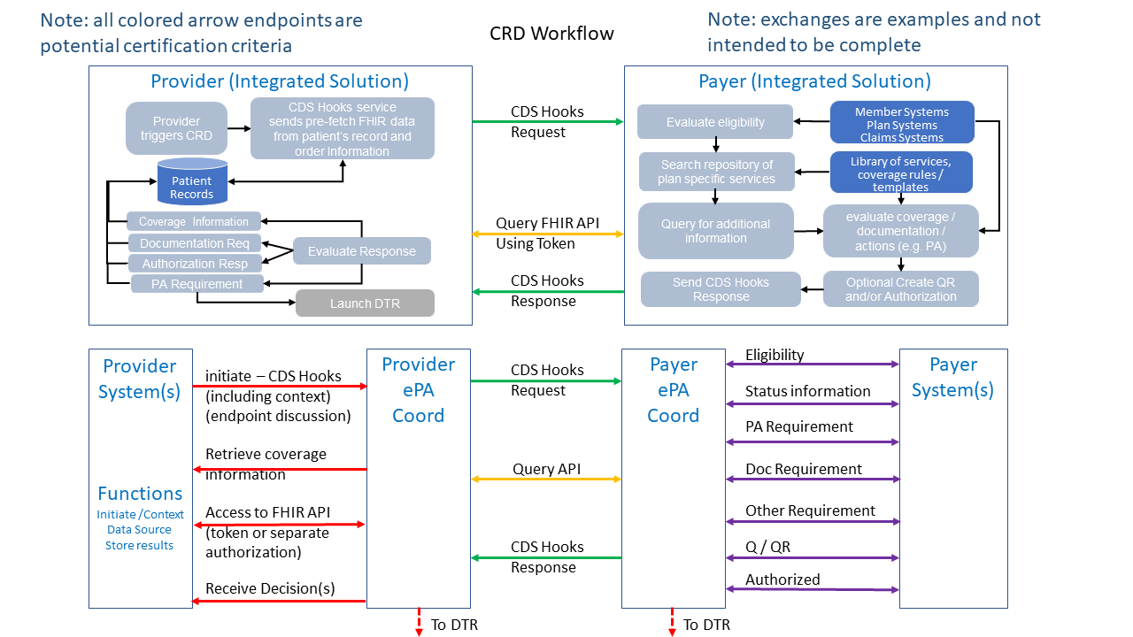
Coordination Diagram

Slide 108
ePA Coordination Considerations
Access tokens are granted to the payer ePA coordinator by the provider ePA coordinator
Must be a single REST endpoint to query (regardless of physical data organization)
Accesses will need to ‘appear’ to be from the ePA coordinator, regardless of payer component seeking data
Decisions about coverage & authorization are from the ‘payer’
Doesn’t matter which subsystem handles which coverage types
If different orders must route through different organizations, ePA is responsible for compiling cards & system actions
Performance requirement is based on response time to and from the provider system, not the individual components
More guidance here

Slide 109
Outline
SDC on DTR Outline
SDC in DTR
Core Expectations
Supporting Elements
Special Elements
CQL in Questionnaires
Architecture Considerations

Slide 110
Summing Up

Slide 111
Course Objectives
After completing this course, you should be able to:
Explain the relationship between CRD and CDS Hooks
List the mandatory and optional hook types used by CRD
Choose the appropriate CRD response type for a particular type of information
Fill out the coverage-information extension
Describe the full workflow covered by the CRD specification

Slide 112



Questions/Discussion
lloyd@dogwoodhealthconsulting.com
Or, better yet, include the community and ask/discuss on https://chat.fhir.org/#narrow/channel/180803-Da-Vinci-CRD

